Slide 1
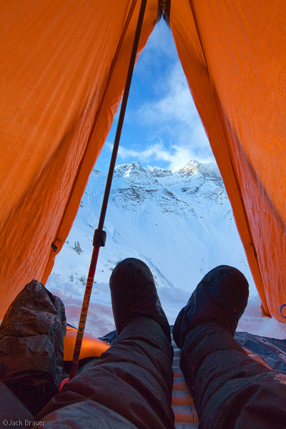
Term 2 Outdoor Ed.
Overnight Trip.
Notes:
We are so excited to be able to offer a second introductory back-country travel elective to Grade 8 and 9 students this semester. With our wilderness overnight coming up in just over a week, the purpose of this video is to provide an overview of the experience, expectations and additional considerations for parents and students.

Slide 2
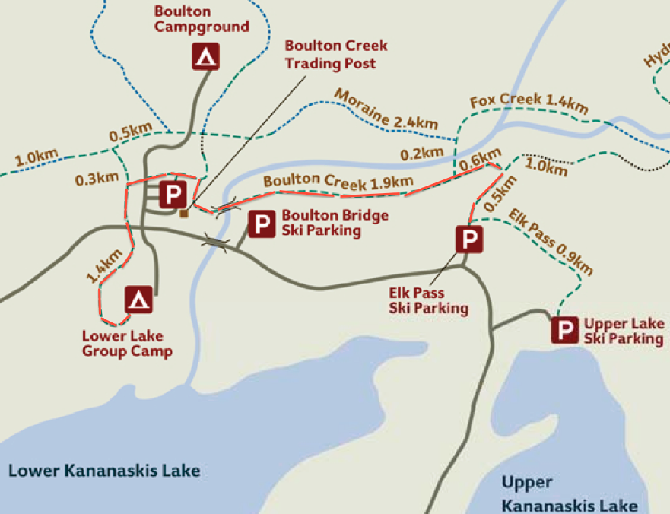
Where we are going
Distance: 5km one way.
Pick-up and drop off
Campsite and
Emergency Evacuation Site
← Canmore (90km) nearest hospital
←Calgary (135km)
Notes:
Our trip will begin at the Elk Pass parking lot in Peter Lougheed Provincial Park just beyondHwy 40. Students will ski along a trail parallel to the Kananaskis trail road for about 2.5 km to before turning to head up to the campground nestled in the trees. The vertical incline is minimal and while the second part of the trail is not track set it is groomed and generally in good condition. In case of emergencies, the campground can be accessed directly from the road.

Slide 3
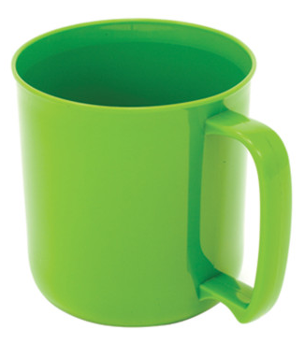
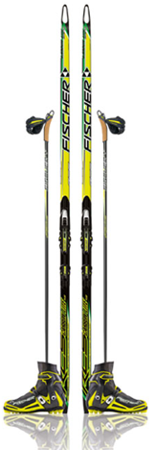
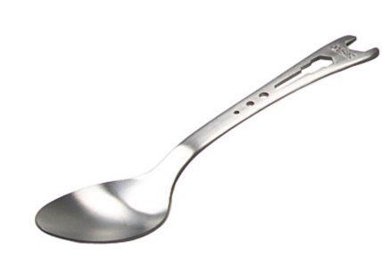
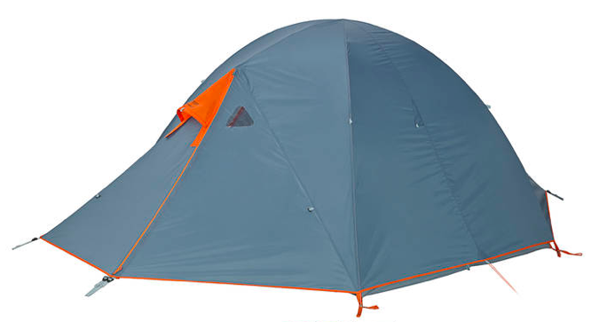
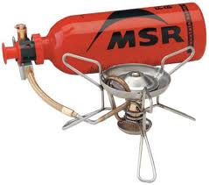
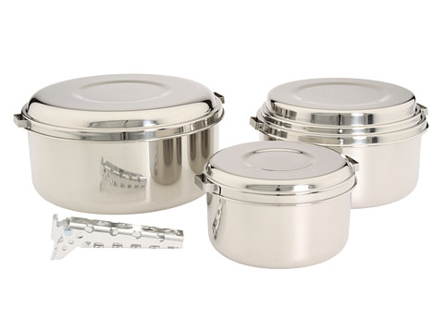
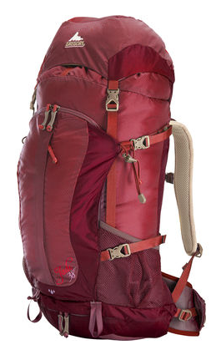
Gear
Personal & Group
Lists and links found on Edmodo
Limited number available from school
Supplied by school
Supplied by school
Supplied by school
Supplied by school
Limited number available from school
Notes:
The school has a class set of MEC Wanderer 4 backcountry tents, MSR whisperlite stoves, cross-country skis and boots, pots sets and cooking utensils which will be provided for each tent group. Students have had the opportunity to work with this equipment during class time and are familiar with its use and care. The school also has a limited number of 50L packs as well as mugs and spoons for students that do not have their own. Students are expected to bring their own warm and waterproof winter boots with ankle support along with rain gear, warm layers, four-season sleeping bags, sleeping pads and water bottles. Please see the gear list attached to the info package for more detail.

Slide 4
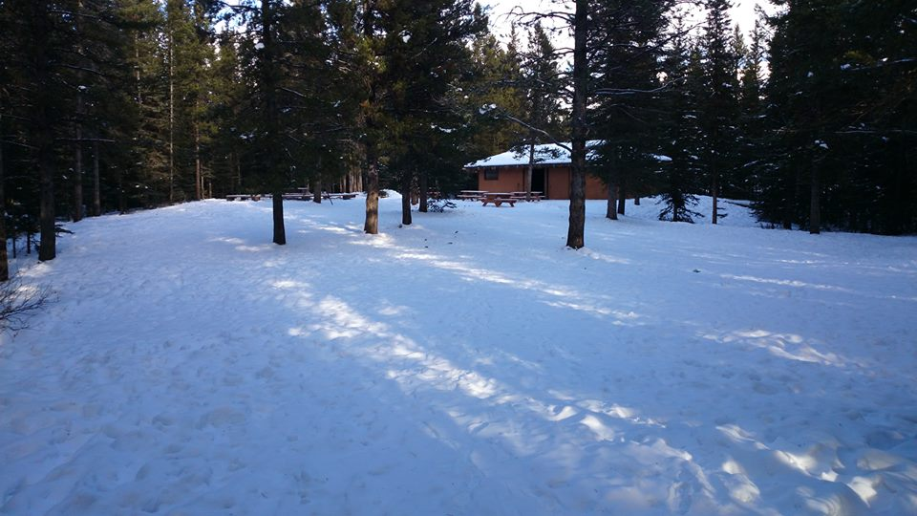
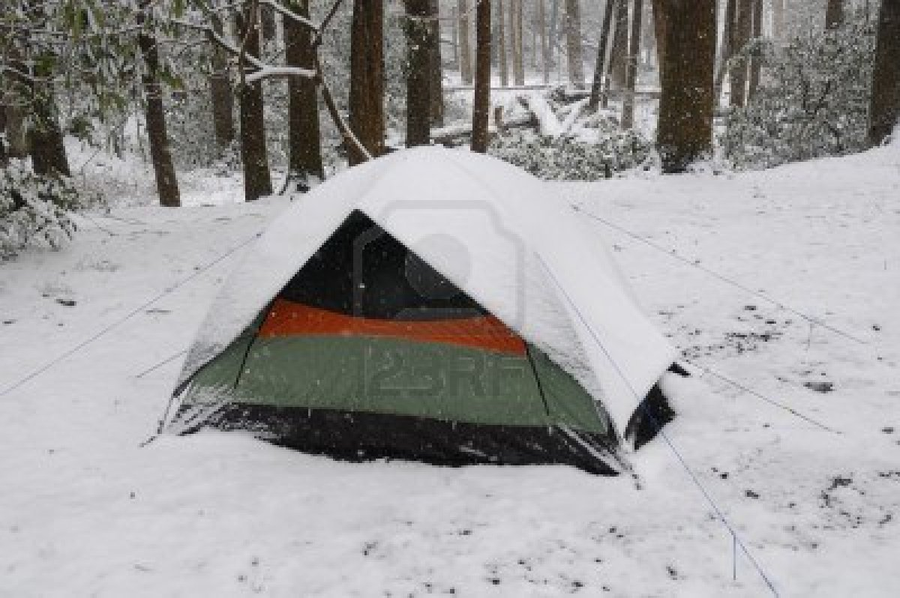
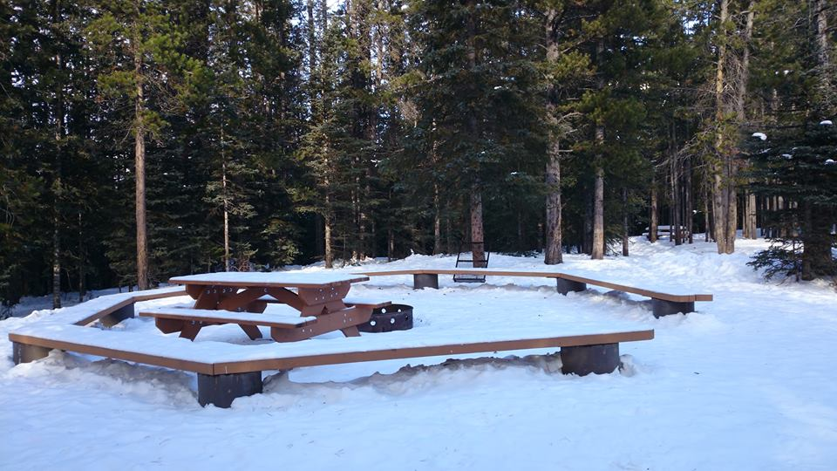
Warm sleeping bag (-20C)
Waterproof layers
Second set of warm long underwear (tops and bottoms)
Winter boots
Extra wool socks!
Extra warm jacket (down/synthetic)
Mountain Weather
Notes:
It is crucial when winter camping, that students bring extra warm and dry layers (including base layers). Wool, fleece or synthetic base layers, wool socks, warm mitts and toques, an extra warm winter jacket for the evenings, and waterproof layers are also imperative as damp warm layers are quickly rendered inefficient. For sleeping, a four season down or synthetic sleeping bag is strongly recommended. Fleece liners can be purchased at MEC and sleeping bags can be doubled up to add extra warmth.

Slide 5
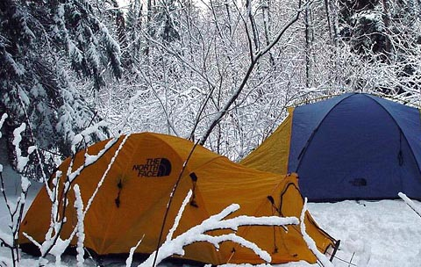
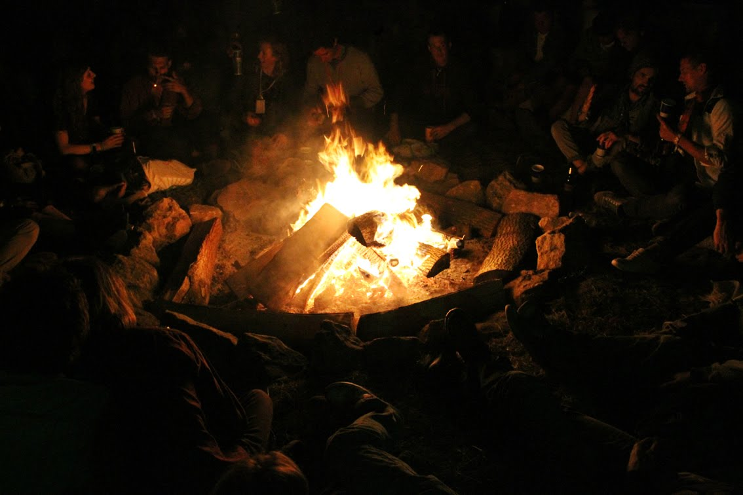
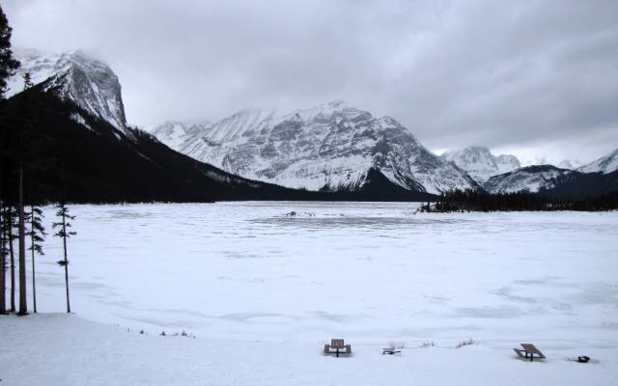
Camping in the back-country
Notes:
The Lower Lake Campground has 9 campsites nestled in the trees. We are expecting two tents of girls and six tents of boys on the trip. The groups will be assigned designated sites with genders intersected by leaders tents. With the exception of at night – groups will meet for meals and activities in the common area around the cook shelter, picnic tables and group fire pit. There is an outhouse located in the trees at the campground and bear lockers for food and smellies storage. Absolutely no food or fragrances will be stored in or near student tents.

Slide 6
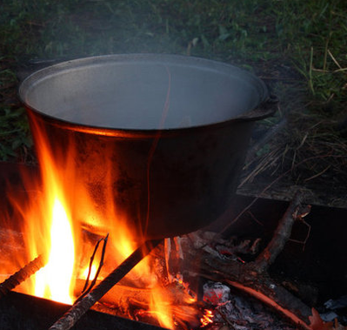
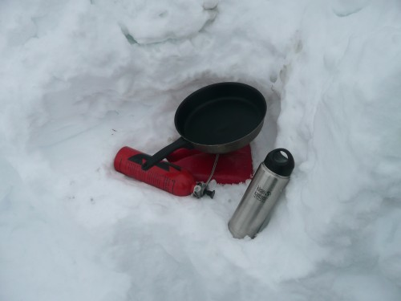
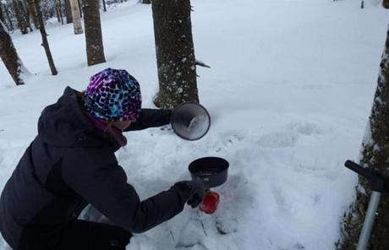
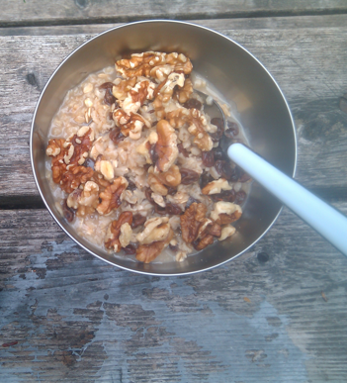
FOOD AND WATER
Notes:
The Lower Lake campground has access to a potable water pump with clean drinking water. Students will be responsible individually for packing lunch materials for both Day 1 and Day 2. Please see food info posted to Edmodo for recommended snacks and lunch items. Students are also responsible for planning, purchasing and cooking one meal for their tent group. Meals should be limited to basic dry foods (pasta, rice, pitas) and meal plans must be submitted and approved on Edmodo prior to Friday, February 21st.

Slide 7
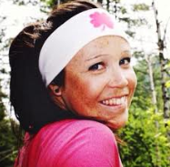
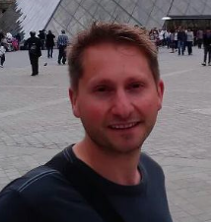
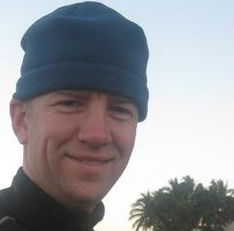
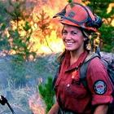
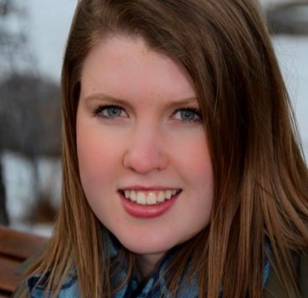
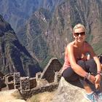
Meet the Group Leaders
Deirdre Bailey
Teacher
OCC Level 1
Advanced Wilderness
First Aid
Background in backcountry
tripping with students
Jason Publack
Teacher
Advanced Wilderness
First Aid
John Cadman
Teacher
OCC Level 1
Advanced Wilderness
First Aid
Background in backcountry
tripping with students
Jackie Zelt
BEd. Student
First Aid and CPR
Varsity Hockey Player
Wilderness Forest Fire Fighter
Megan Hodgson
BEd. Student
First Aid and CPR
Former OE student and
Volunteer leader (Vincent Massey)
Emily Miklos
BEd. Student
Nationally Certified Coach
City of Calgary Outdoor Leader
Foothills OE programs graduate
Notes:
As co-Outdoor Ed teacher, Mrs. Bailey is at the lead of this back-country excursion. Mrs. Bailey has a background in leading backcountry excursions as a staff member at YMCA Camp Chief Hector, a student teacher with the Vincent Massey backcountry expedition programs and a backcountry camping and skiing enthusiast. Our second Outdoor Ed teacher Mr. Publack has a tremendous amount of experience working with youth in all environments through to high school, a ridiculous amount of enthusiasm and as a Saskatchewan native is building his repertoire of backcountry experiences in the rockies. Mr. Cadman spent years working as a back-country leader prior to his teaching career and lead the inaugural CSS backcountry camping expedition to Quaite Valley last spring with his Grade 6/7 Elective. Ms. Zelt and Ms. Miklos are student teachers with the PE program at CCS this term. They both have a background in and passion for outdoor education and are so excited to be accompanying our group on this trip. Ms. Zelt has experience in the outdoors as a wilderness firefighter and Ms. Zelt recently hiked Machu Pichu on a multi-month excursion to Peru. Ms. Hodgson is joining us as Mr. Publack’s student teacher this term. Ms. Hodgson participated extensively in Outdoor Education programs through both Jr. High and high school and credits the opportunity with her current passion for exploring the outdoors. We are so excited to have these teachers along!

Slide 8
Student Expectations
Students have been expected to consistently demonstrate the acquisition and consolidation of these basic skills and attitudes throughout the course in order to be eligible for participation in the Outdoor Expedition overnight component.
Responsibility (effort)
Initiative
Teamwork
Trustworthiness
Positivity and gratitude
Leadership
Inclusivity
Commitment
Notes:
Due to the high risk nature of back-country travel, this course has demanded a great deal of responsibility and effort from students. With 32 students enrolled it has not been possible for teachers to stay on top of each student at each stage of the process and as a result many students have stepped up their commitment to taking initiative and showing leadership in order to prove their eligibility for the trip. Students participating in this experience are expected to be 100% responsible for their gear, food and clothing and to be able to troubleshoot or volunteer help as needed. With 5 experienced leaders volunteering their time to make this inaugural trip possible, we feel confident that our students will be conscious of showing the utmost respect, gratitude and courtesy to each other, trip leaders and the environment on this trip in order to set a positive precedent for future back-country excursions.

Slide 9
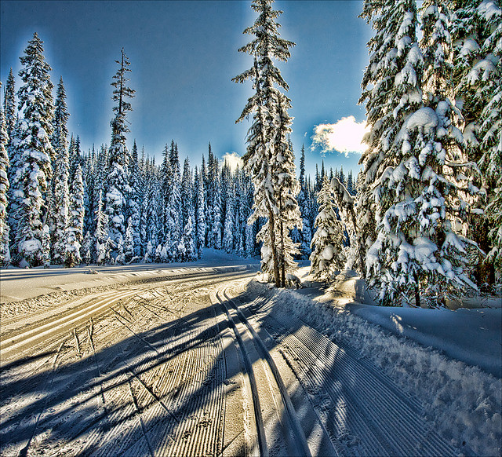
Question & Answer
Wednesday, February 19th
Or via email:
deirdre.b@calgaryscienceschool.com
jason.p@calgaryscienceschool.com

